Slide 1
CPI-DTB-MedTech-NA-Sterilmed ERP Migration Phase 0 - Report Out Deck
Role – Project Lead
Name – Troy Engel
Date – 3/1/2024

Slide 2
Executive Summary
Problem Statement | Sterilmed supply chain is not integrated to the J&J MT existing processes and systems. Sterilmed is technically hosted in an aging platform, with capability gaps that require the business to develop manual processes that are inefficient and impact the effectiveness of service delivery and ultimately not able to support expected growth in business.
Goal Statement | Migrate to existing CSS solution with required capabilities to support business growth as a bridge to S4 long-term solution (2033). Sterilmed will require adoption of existing CSS business processes and redesign for process gaps. CPI to document current state processes and systems landscape, fit-to-standard USROTC process assessment and design of required process changes with identification of process efficiency opportunities.
Business Value Statement​ | ​Reduce manual processes that are inefficient and impact the effectiveness of service delivery and ultimately not able to support expected growth in business. Migrate to existing CSS solution with required capabilities to support business growth as a bridge to S4 long-term solution (2033)
Opportunity | Methods & Analysis | Findings | Recommendations
Migrate to existing CSS (Cardiovascular & Specialty Solutions) tech solution with required capabilities to support business growth as a bridge to S4 long-term solution (2033) and counter risk as support ends in 2026 for existing ERP. Enable a competitive advantage in the Ambulatory Surgery Centers (ASC) environment into CSC-Model-N (new contracting model software). Reduce tech complexity by eliminating OFC Quoting System, Sterilmed Datawarehouse, SQL reporting services, Jabil staging database, SIS (Sterilmed Information System) and adopting Planning and Contracting Microsoft databases. | Order To Cash & Procure 2 Pay 17 E2E current state business process flow maps at high to mid-level detail required for Phase 0 Visibility into key process activities and actors Identification of efficiency opportunities Map systems landscape supporting business Workshop for fit gap analysis - OTC (USROTC) & P2P (Ariba/SAP Lynx)* ERP (BWI JDE) Design process changes to accommodate USROTC Design and quantify future state improvements in collaboration with Business and IT partners Ensure teams have information needed to submit aCAR for review 21 Preliminary Future State Design Concept Maps at Mid to High Level supporting aCAR submission to the Steering Committee. Revisit after design and test phases to create proper level 3 end to end process maps. | Identified 2 process gaps out of the 50 Workshop Sterilmed capability concerns and sub process pain point / Sterilmed Capability Requirement. So a fit gap percentage of 96%. Quoting and Jabil staging data are gaps. The Great Plains system is embedded and integrated into every function and process for the Sterilmed business. Microsoft has announced end of support to Great Plains by 2026. Pricing and Contracting spends about 75% of their time, 800 hours annually, manually tracking keystrokes in the Great Plains system to support required business controls. Planning: BWI JDE automatically calculates inventory. The hours eliminated would be ~100 hours/year, when you factor in the time doing Accounts Receivables: Save 75 FTE Hours by using USROTC existing connection BtB eliminating manual entry that was done in Great Plains. All accounts receivables and procurement done on Great Plains system. Leverage USROTC system and Credit Request team that does this for BWI currently. # of Rework loops = 19 # of hand offs = 89 # of Independent starts = 27 # of non-value-added steps = 35 | Enable a competitive advantage in the Ambulatory Surgery Centers (ASC) leveraging CSC (Model N) Migrate Sterilmed ERP onto CSS BWI JDE and leverage existing / common processes for USROTC, MDM and Corporate systems as an intermediate solution ahead of full TranSCend. Move procurement to eMarketplace, Ariba, Lynx, OneASL, USROTC, and BtB NA. For accounts receivable use USROTC, HighRadius, Aravo, and BtB NA. 3 customized solutions to be created in BWI JDE: 1) Jabil staging tables (32) 2) Quoting process 3) BWI JDE can send excess inventory to the Data Warehouse, and we can create a report showing excess inventory in USROTC. GPO ID #: Sterilmed currently maintains a very manual process to update the data field “GPO ID” in our SIS System (our Customer Master) linked to the appropriate SMID/UCN. Therefore, utilize GPO rosters that are currently being loaded into MDM and then flow to ICS (Model N) for all customer accounts that Sterilmed does business with. For Canada customers: Reduce Complexity by giving the 2 customers a date in which they need to be transitioned to “Open loop” by, then we’ll be shutting down closed loop. loop” by, then we’ll be shutting down closed loop.
Quantitative Business Value
Metric​ | White $​
IT Savings $ | ​752,000
Business ​Hours Reduction | ​975 hours
Total​
Expected Realization Timeline​ | 2023​ | 2024​ | 2025​ | 2026​ | 2027​ | Total​
White $​ | $​ | $​ | $​ | $​ | $​752,000 | $​
Green $​ | $​ | $​ | $​ | $​ | $​ | $​

Slide 3
Define

Slide 4
CPI Scope of Work
Sterilmed ERP Migration – Phase 0
Provide process discovery and analytics services utilizing lean six sigma methodologies delivering current state process and systems landscape insights, fit-to-standard USROTC process assessment and design of required process changes.
Design and quantify future state improvements in collaboration with Business and IT partners with the ultimate goal to successfully deliver technology and process design solutions aligned with project goals.
Processes
Systems
Fit gap analysis
Design process changes to accommodate USROTC processes
Quantification of anticipated efficiency or effectiveness business impacts
Map systems landscape supporting business processes
Identification of manual, systems supported and automated process steps
Future State
OTC & P2P*
E2E business process flow mapping at high to mid-level detail required for Phase 0
Visibility into key process activities, workflow and actors
Identification of efficiency, effectiveness and automation opportunities
*Further scoping of sub-processes required during next steps – discovery and chartering

Slide 5
CPI Charter – MT NA
Sterilmed ERP Migration
SOW | TBD – Entered by CPI
Project ID
Z-Code
Finance Approver
Business Approver | Ramos, Conrado, Sr Dir RPO Comm
Head of Technology (HoT) | Eric Bateh (Garg, Manish)
Project Champion | Brown, Alejandra SCG SM - Commercial
Project Sponsor | Ramos, Conrado, Sr Dir RPO Comm Fernando Diaz, E2E Sterilmed
CPI Owner | Mary Ann Kopinski /Sean Authier
CPI Lead | Troy Engel
Problem Statement | Sterilmed supply chain is not integrated to the J&J MT existing processes and systems. Sterilmed is technically hosted in an aging platform, with capability gaps that require the business to develop manual processes that are inefficient and impact the effectiveness of service delivery and ultimately not able to support expected growth in business.
Goal Statement | Migrate to existing CSS solution with required capabilities to support business growth as a bridge to S4 long-term solution (2033). Sterilmed will require adoption of existing CSS business processes and redesign for process gaps. CPI to document current state processes and systems landscape, fit-to-standard USROTC process assessment and design of required process changes with identification of process efficiency opportunities.
Business Processes in Scope
Process Name | Start / End Boundaries | Process Output | Primary Customer | Key KPI’s
Pricing and Contracting | New business / Final agreement | Contract and pricing agreement | External customer
Devise Reprocessing (WIP & FG Mgmt) | Collection / FG Inventory Receipt | Reprocessed devise available | Customer service
Order To Cash (OTC) | Create Quote / Invoice Creation | Payment processed | External customer
Procure to Pay (P2P) – SC/AP | Requisitioning / Payment | Direct & indirect goods received | Reprocessing & support functions
MDM (customer/supplier) | Set up / maintain / deactivate | Accurate and complete master data
CPI Deliverables | Definition(s) / Client Expectations | Completion Date
Current State Processes and Interviews | We will conduct interviews with approximately 20 people to understand pain points in the current way of working and possible gaps and needs with the processes. We will facilitate the Current State Process Map of the process with current state cycle time and details where metrics are currently gathered. Deliverable: process map in Visio | MM/DD/YYYY
Future State Processes fit-to standard w/gap assessment | This deliverable will include fit-to-standard detailed Future State Process Maps w gap process designs, Future State Roles and Responsibilities, and alignment of those roles to the Future State Processes. This will be conducted during workshop which will include process definitions and tabletop exercises. Deliverable: process map in Visio | MM/DD/YYYY
Improvement opportunities with associated value | This Deliverable will include a list of improvements, which includes both process change and organizational change recommendations. This includes recommended metrics and associate potential business value. This will also include a review of the recommendations with the leadership team and refinement of the recommendations based on feedback. Deliverable: CPI project execution slide deck | MM/DD/YYYY

Slide 6
Availability of Core Team and SMEs is a critical success factor for CPI Engagements.
Identifying SMEs and obtaining their commitment to participate is a primary aspect of the Project Champion role.
Business Processes in Scope / SMEs
Process Area | Start Boundary | End Boundary | Key Contacts
Pricing and Contracting | New business | Final agreement | Julie Steible | jsteibl@its.jnj.com
Devise reprocessing (WIP & FG Mgmt) – perhaps just the integration with Jabil system | Dirty device collection | Released to FG inventory | Jabil – Brad Geiss | bgeiss@its.jnj.com
OTI – Quote creation (dependent on # collected from facilities each week or from inventory) | Customer demand received | Customer accepts quote | Crystal King | cking31@its.jnj.com
OTI – SO creation | Customer quote acceptance | Order creation | Crystal King | cking31@its.jnj.com
OTI – Order fulfillment | Order receipt | Delivery | Brad Geiss, Crystal King | bgeiss@its.jnj.com cking31@its.jnj.com
ITC – Invoice to cash - AR | Invoice creation | Invoice clearance | Zack Devoti, Laura Peterson | zdevoti@its.jnj.com lpeter26@its.jnj.com
Procurement – SC | Requisitioning | Goods receipt | Brad Geiss, Rose McDonough, Robert Johnson | bgeiss@its.jnj.com rmcdono@its.jnj.com rjohns98@its.jnj.com
Procurement - AP | Goods receipt | Payment | Zack Devoti, Laura Peterson | zdevoti@its.jnj.com lpeter26@its.jnj.com
MDM (Customers/Suppliers) | Set up | Deactivate | Julie Steible, Crystal King, Brad Geiss | jsteibl@its.jnj.com cking31@its.jnj.com bgeiss@its.jnj.com
Notes:
Data
Systems
Cycle Times / TT / LT
Output
Customers
KPIs that drive business case

Slide 7
Service Type | Traditional CPI
Business Case ($) | Impact to sales – growth rate (Ale will research) Elimination of manual processes – efficiency gains (?capacity expansion)
Expected Realization Timeline | 2023 | 2024 | 2025 | 2026 | 2027 | Total
White $ | $ | $ | $ | $ | $ | $
Green $ | $ | $ | $ | $ | $ | $
Business Value Statement (Qualitative/Quantitative) | Reduce manual processes that are inefficient and impact the effectiveness of service delivery and ultimately not able to support expected growth in business. Migrate to existing CSS solution with required capabilities to support business growth as a bridge to S4 long-term solution (2033).
Additional Details / Notes
Enter additional details as required
Data Availability | Score Before Project | Score After Project
Enter a rating for anticipated data availability | 1-5 (Poor -1 Excellent -5) | 1-5
Key KPI(s) Notes
Ex. Key Success Metrics; Source systems(s)
Supply Chain Org (See notes below for options) | MT-CSS-Sterilmed
APL (See notes below for options) | ERP – SAP Other
Type of Initiative (See notes below for options) | Transform
Start Date | 09/25/2023
End Date | 11/24/2023
Duration (weeks) | 9 week duration with total 10 weeks effort
Resource Time Allocation | Total Hours | Jan | Feb | Mar | Apr | May | Jun | Jul | Aug | Sep | Oct | Nov | Dec | Travel $$
Troy Engel | 360 | - | - | - | - | - | - | - | - | 40 | 176 | 144 | - | $2,500
Workshop support | 40 | - | - | - | - | - | - | - | - | - | - | 40 | - | $2,500
TOTAL | 400 |  |  |  |  |  |  |  |  |  |  |  |  | $ 5,000
Notes:
Service Type: Standard CPI, Process Mining, IA/RPA, Process Simulation, Credo, Unfunded, Coaching, Task Mining, Skills Based Volunteering
Region: ASPAC, EMEA, LATAM, NA, Global
Supply Chain Organization:
Enterprise Supply Chain
CBT
Deliver
Enterprise Quality
Procurement
S&D
Supply Chain
Janssen
MedTech
CSS
Acclarent
Biosense Webster
Cerenovus
Mentor
Sterlmed
Not Applicable
DPS
Cements
Joint Reconstruction
Power Tools
Spine
Sports and Shoulders
TECA
ETH
Biosurgery
Digital Surgery
Endo Mechanic
Wound Closure
Not Applicable
HMD
Not Applicable
Vision
Surgical Vision
Vision Care
Not Applicable
APL
Customer Connectivity
Analytics
Customer Experience
Digital Channels
Digital Contracts Management
Hospital Systems Integration & Order Management
Data
ERP
Bolt-On Non SAP or Oracle/JDE
Bolt-On Oracle
Bolt-On SAP
Data and Analytics
Integrations
Non-SAP or Oracle
Oracle/JDE
Product Identification and Brand Protection
SAP-Cross Application Models
SAP-Finance/Accounting
SAP-Logistics
SAP-Other
SAP-Supply Chain Management
SAP-Technical
Integrated Solutions
Acquisitions and Divestitures
Data and Analytics
Supply Chain Programs
Logistics
Data Acquisition
Distribution
Engineering Facilities
Labeling and Printing
Transportation
Make
Asset Management
Automation & Data
Digital Associate
Digital Factory
Engineering/Facilities
Enterprise Resource Management
Historian
Labeling/Content Management
Make Data
MedTech
MES
Pharma Manufacturing
Serialization
Surgical Vision
Vision Contact
Visual Factory
Type of initiative:
Run-Base
Run-Compliance
Grow: if we are enhancing existing business capabilities
Transform: helping business do things differently

Slide 8
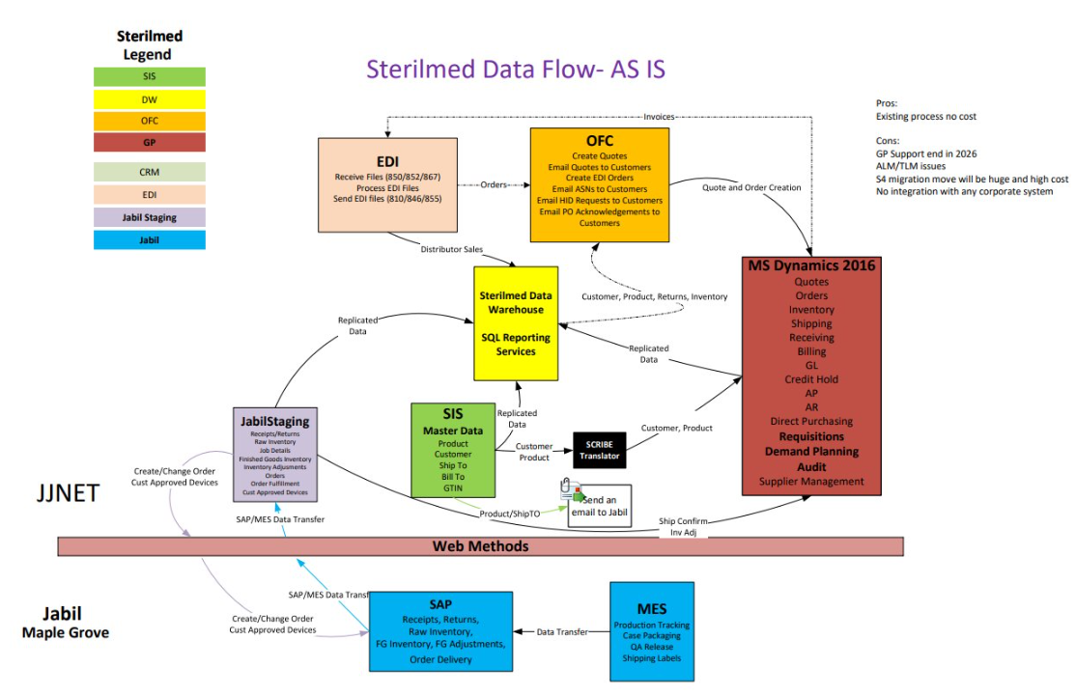
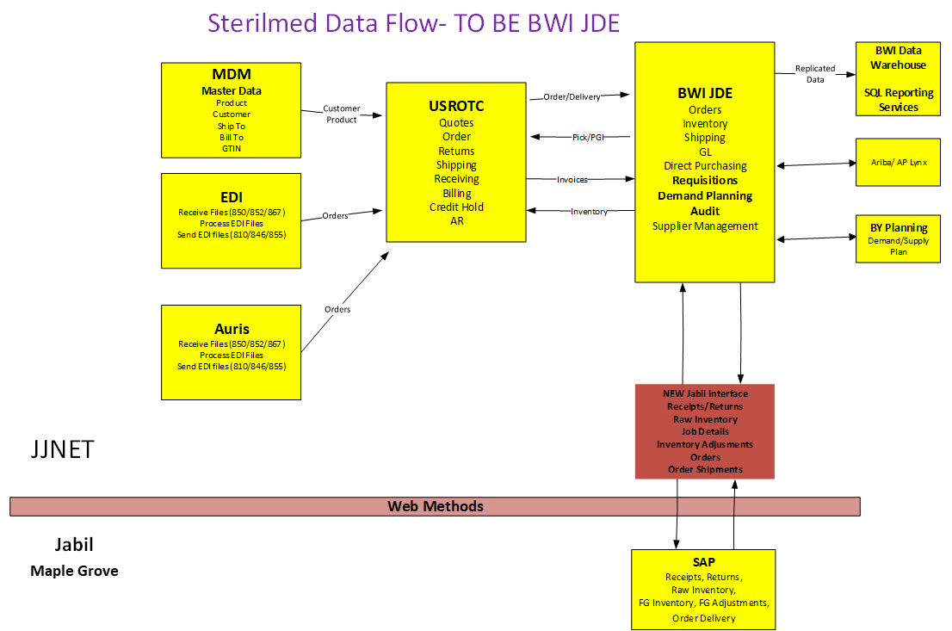
Technical Solution
X = Not on the MedTech CSS roadmap
Current State
Proposed Future State
X
X
X
X
X

Slide 9
Project Plan

Slide 10
Measure

Slide 11
Current State SIPOC
Sterilmed ERP Migration – Tech Design Phase 0 – End to End Current State Process
Supplier
Input
Process
Output
Customer
Sterilmed customer
1. Request for set up of Sterilmed customer / supplier
See
Next
Slide
1. Accurate and complete master data
External Sterilmed customer
Reprocessing & support functions
2. New business engagement request
2. Final agreement on Contract and pricing
Reprocessing & support functions
Customer service
3. Requisitioning direct & indirect goods
3. Payment & Direct & indirect goods received
Customer service
Master data management (MDM) team
Master data management (MDM) team
4. Collection of devices from custom
4. FG Inventory Receipt & Reprocessed device available & delivered
Finance Teams
5. Create order to cash quote
Finance Teams
5. Invoice creation and payment processed
Pricing & Contracting
Pricing & Contracting
6. Request to maintain / deactivate Sterilmed customer
6. Deactivated account

Slide 12
SIPOC Level Current State Process
Sterilmed ERP Migration – Tech Design Phase 0 – End to End Current State Process
1. Planning
2. Customer Service
3. Supplier Maintenance
Supply Chain Upload Product Master Data
Customer Account Management
Setup to Update or Deactivate
4. Pricing & Contracting
5. Procure to Pay (P2P)
6. Device Reprocessing
New Business to Final Agreement
SC Requisitioning to Goods Receipt
Dirty Device Collection to Released FG Inventory
7. Procure to Pay (P2P)
AP Goods Receipt to Payment
9. OTI – SO Creation
Customer Quote Acceptance to Quote Creation
10. OTI- Order Fulfillment
Order Receipt to Delivery
11. Invoice to Cash – AR
Invoice Creation to Clearance & Credit Requests
8. OTI – Quote Creation
Customer Demand Received to Customer Accepts Quote

Slide 13
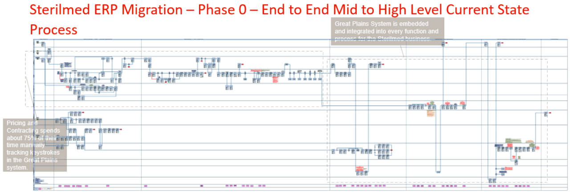
Current State Process Flow & Measurement
Process Metric | AS-IS | TO-BE
# Total Mid to High Level Steps | 493
# Value Added (VA) Mid to High Level Steps | 458
# Non-Value-Added Mid to High Level Steps | 35
# Hand Offs | 89
Cycle Time (days) For All Contracting Agreements | 17
Cycle Time (days) Contracting Excluding PCLs | 25
Touch Time (hours) Reduction |  | 899
Process Metric | AS-IS | TO-BE
# Rework Loops | 19
Independent Starts in the Process | 27
# of Pain Points | 23
# of Process Improvement Ideas | 13
# of Sterilmed Business Capability Requirements | 11
Sterilmed growth rate year over year percentage | 47%

Slide 14
Current State Process Analysis
Sterilmed ERP Migration – Tech Design Phase 0 – End to End Mid to High-Level Current State Process
Process Leverage Point | Pain Point Headlines | Impact to Process
The Great Plains system is embedded and integrated into every function and process for the Sterilmed business. | Microsoft has announced end of support to Great Plains by 2026. | Need to Migrate Sterilmed ERP onto CSS JDE and leverage existing / common processes for USROTC, MDM and Corporte systems.
Pricing and Contracting spends about 75% of their time manually tracking keystrokes in the Great Plains system in order to support required business controls. | Great Plains is not a contracting system so nearly all Pricing and Contracting steps are manually controlled in Access Databases to support the business needs. | All manual process add up to 800 hours of wasted effort each year that would go away if with a proper Pricing and Contracting system.
Sterilmed SMEs have documented 13 process improvement ideas and 11 Sterilmed business capability requirements. | Sterilmed SMEs have documented 23 pain points. | Need to Migrate Sterilmed ERP onto CSS JDE and leverage existing / common processes for USROTC, MDM and Corporte systems.

Slide 15
Current State Sub-Process Analysis
Sterilmed ERP Migration – Tech Design Phase 0 – Customer Service Mid-Level Current State Sub-Process
Process Leverage Point | Pain Point Headlines | Impact to Process
Order processing flow from GP to Jabil. System is SQL. Orders created in GP flows to Jabil via SQL job Jabil Order. | Great plains has a lot of custom coding support the Jabil GHX EDI order processing that needs to be replicated in USROTC. | Need to make sure all the existing Jabil functionality on USROTC system.
For Auris customers, there are data modifications done to update fields like OPCO Po Number, Customer PO Number, Third party Account Number, Carrier Account Number, Carrier Name, Zip Code. | Auris customers need to have the exact same custom process they have today in Great Plains. | Need to have the same process in USROTC.
New system needs to have the shipping options that match Jabil. | We also still have FedEx options as Auris is trying to use FedEx, but otherwise below are the only options we select today. Just need to ensure we pitch we have something similar going forward. | Need to have the same process in USROTC.

Slide 16
Analyze

Slide 17
Fit Gap Assessment Results
Sterilmed ERP Migration – Tech Design Phase 0 – Mid to high level assessment results as a data-centered rationale for an intermediate solution ahead of full TranSCend.
2 gaps on 50 Sterilmed Capability Concerns = Fit to Gap of 96%
Notes:
% Fit
Key process areas of direct fit
Key process areas of currently manual work that will be automated due to future state tech solution
Key process areas that can be eliminated due to future state processes
Key areas that will be transformed (change in Sterilmed processes that will gain efficiency or effectiveness)
% Gap
Key areas that are not a fit to the CSS solution
What is the business decision for those areas?
Change business process to adopt CSS solution in that area
Continue Streamed process outside CSS standard process
Any initial $ calcs

Slide 18
Fit Gap Assessment Results
Sterilmed ERP Migration – Tech Design Phase 0 – Determine Responsibility for Shutting Down Systems
Notes:
% Fit
Key process areas of direct fit
Key process areas of currently manual work that will be automated due to future state tech solution
Key process areas that can be eliminated due to future state processes
Key areas that will be transformed (change in Sterilmed processes that will gain efficiency or effectiveness)
% Gap
Key areas that are not a fit to the CSS solution
What is the business decision for those areas?
Change business process to adopt CSS solution in that area
Continue Streamed process outside CSS standard process
Any initial $ calcs

Slide 19
Fit Gap Assessment Results
Sterilmed ERP Migration – Tech Design Phase 0 – End to End Process
Notes:
% Fit
Key process areas of direct fit
Key process areas of currently manual work that will be automated due to future state tech solution
Key process areas that can be eliminated due to future state processes
Key areas that will be transformed (change in Sterilmed processes that will gain efficiency or effectiveness)
% Gap
Key areas that are not a fit to the CSS solution
What is the business decision for those areas?
Change business process to adopt CSS solution in that area
Continue Streamed process outside CSS standard process
Any initial $ calcs

Slide 20
Fit Gap Assessment Results
Sterilmed ERP Migration – Tech Design Phase 0 – Planning Assessment Results
Notes:
% Fit
Key process areas of direct fit
Key process areas of currently manual work that will be automated due to future state tech solution
Key process areas that can be eliminated due to future state processes
Key areas that will be transformed (change in Sterilmed processes that will gain efficiency or effectiveness)
% Gap
Key areas that are not a fit to the CSS solution
What is the business decision for those areas?
Change business process to adopt CSS solution in that area
Continue Streamed process outside CSS standard process
Any initial $ calcs

Slide 21
Fit Gap Assessment Results
Sterilmed ERP Migration – Tech Design Phase 0 – Pricing & Contracting Assessment Results
Notes:
% Fit
Key process areas of direct fit
Key process areas of currently manual work that will be automated due to future state tech solution
Key process areas that can be eliminated due to future state processes
Key areas that will be transformed (change in Sterilmed processes that will gain efficiency or effectiveness)
% Gap
Key areas that are not a fit to the CSS solution
What is the business decision for those areas?
Change business process to adopt CSS solution in that area
Continue Streamed process outside CSS standard process
Any initial $ calcs

Slide 22
Fit Gap Assessment Results
Sterilmed ERP Migration – Tech Design Phase 0 – Procure to Pay Assessment Results
Notes:
% Fit
Key process areas of direct fit
Key process areas of currently manual work that will be automated due to future state tech solution
Key process areas that can be eliminated due to future state processes
Key areas that will be transformed (change in Sterilmed processes that will gain efficiency or effectiveness)
% Gap
Key areas that are not a fit to the CSS solution
What is the business decision for those areas?
Change business process to adopt CSS solution in that area
Continue Streamed process outside CSS standard process
Any initial $ calcs

Slide 23
Fit Gap Assessment Results
Sterilmed ERP Migration – Tech Design Phase 0 – Customer Quoting Assessment Results
Notes:
% Fit
Key process areas of direct fit
Key process areas of currently manual work that will be automated due to future state tech solution
Key process areas that can be eliminated due to future state processes
Key areas that will be transformed (change in Sterilmed processes that will gain efficiency or effectiveness)
% Gap
Key areas that are not a fit to the CSS solution
What is the business decision for those areas?
Change business process to adopt CSS solution in that area
Continue Streamed process outside CSS standard process
Any initial $ calcs

Slide 24
Fit Gap Assessment Results
Sterilmed ERP Migration – Tech Design Phase 0 – Customer Service Order Processing Assessment Results
Notes:
% Fit
Key process areas of direct fit
Key process areas of currently manual work that will be automated due to future state tech solution
Key process areas that can be eliminated due to future state processes
Key areas that will be transformed (change in Sterilmed processes that will gain efficiency or effectiveness)
% Gap
Key areas that are not a fit to the CSS solution
What is the business decision for those areas?
Change business process to adopt CSS solution in that area
Continue Streamed process outside CSS standard process
Any initial $ calcs

Slide 25
Fit Gap Assessment Results
Sterilmed ERP Migration – Tech Design Phase 0 – Accounts Receivables Assessment Results
Notes:
% Fit
Key process areas of direct fit
Key process areas of currently manual work that will be automated due to future state tech solution
Key process areas that can be eliminated due to future state processes
Key areas that will be transformed (change in Sterilmed processes that will gain efficiency or effectiveness)
% Gap
Key areas that are not a fit to the CSS solution
What is the business decision for those areas?
Change business process to adopt CSS solution in that area
Continue Streamed process outside CSS standard process
Any initial $ calcs

Slide 26
Fit Gap Assessment Results
Sterilmed ERP Migration – Tech Design Phase 0 – Reporting Assessment Results
Notes:
% Fit
Key process areas of direct fit
Key process areas of currently manual work that will be automated due to future state tech solution
Key process areas that can be eliminated due to future state processes
Key areas that will be transformed (change in Sterilmed processes that will gain efficiency or effectiveness)
% Gap
Key areas that are not a fit to the CSS solution
What is the business decision for those areas?
Change business process to adopt CSS solution in that area
Continue Streamed process outside CSS standard process
Any initial $ calcs

Slide 27
Fit Gap Assessment Results
Sterilmed ERP Migration – Tech Design Phase 0 – Non-Collection Returns, Vendor renewal and Business Scenarios Assessment Results
Notes:
% Fit
Key process areas of direct fit
Key process areas of currently manual work that will be automated due to future state tech solution
Key process areas that can be eliminated due to future state processes
Key areas that will be transformed (change in Sterilmed processes that will gain efficiency or effectiveness)
% Gap
Key areas that are not a fit to the CSS solution
What is the business decision for those areas?
Change business process to adopt CSS solution in that area
Continue Streamed process outside CSS standard process
Any initial $ calcs

Slide 28
Preliminary Future State Design Concept Maps at Mid to High Level supporting aCAR submission to the Steering Committee – Revisit after design and test phases
Future State Process Design
Sterilmed ERP Migration – Tech Design Phase 0 – Mid to High Level Design
Comparison to Current State - Sterilmed ERP Migration – Phase 0: Sterilmed ID (SMID) / GPO ID Creation
Current State
Key Efficiencies Gained:
Pricing and Contracting spends about 75% of their time, 800 hours annually, manually tracking keystrokes in the Great Plains system to support required business controls.
Most notable finding is GPO ID #: Sterilmed currently maintains a very manual process to update the data field “GPO ID” in our SIS System (our Customer Master) linked to the appropriate SMID/UCN.
MDM Team says GPO rosters are loaded first into MDM as a one to many relationship and then flow to ICS (Model N) so this work may be done but needs to be tested.
Future State

Slide 29
Preliminary Future State Design Concept Maps at Mid to High Level supporting aCAR submission to the Steering Committee – Revisit after design and test phases
Future State Process Design
Sterilmed ERP Migration – Tech Design Phase 0 – Mid to High Level Design
Comparison to Current State - Sterilmed ERP Migration – Phase 0: Inventory Valuation
Current State
Key Efficiencies Gained:
BWI JDE automatically calculates inventory
The hours eliminated would be ~100 hours/year, when you factor in the time doing inventory tie outs and manual revaluation at year end.
Future State

Slide 30
Preliminary Future State Design Concept Maps at Mid to High Level supporting aCAR submission to the Steering Committee – Revisit after design and test phases
Future State Process Design
Sterilmed ERP Migration – Tech Design Phase 0 – Mid to High Level Design
Comparison to Current State - Sterilmed ERP Migration – Phase 0: Accounts Payable
Current State
Key Efficiencies Gained:
No gaps and Eliminate all dependencies on Great Plains and moving to standard existing processes and systems such a USROTC, BtB NA, Aravo, HighRadius.
Save 75 FTE Hours by using USROTC connection exists already to BtB eliminating manual entry that was done in Great Plains.
Leverage USROTC system and Credit Request team that does this for BWI currently.
If we improve this Gross To Net process and close process overall, then Sterilmed may no longer need to close its books 3 days earlier than the rest of the J&J MedTech operating companies
Future State

Slide 31
Preliminary Future State Design Concept Maps at Mid to High Level supporting aCAR submission to the Steering Committee – Revisit after design and test phases
Future State Process Design
Sterilmed ERP Migration – Tech Design Phase 0 – Mid to High Level Design
Comparison to Current State - Sterilmed ERP Migration – Phase 0: Procure to Pay (P2P)
Current State
Key Efficiencies Gained:
No gaps
Eliminate all dependencies on Great Plains and moving to standard existing processes and systems It will be like the current process for BWI US (LE 6010) where the Indirect Procurement validation is in BtB NA and the invoices from LYNX go into BtB NA.
eMarketplace, Ariba, Lynx, OneASL, USROTC, BtB NA,
Future State

Slide 32
Preliminary Future State Design Concept Maps at Mid to High Level supporting aCAR submission to the Steering Committee – Revisit after design and test phases
Future State Process Design
Sterilmed ERP Migration – Tech Design Phase 0 – Mid to High Level Design
Comparison to Current State - Sterilmed ERP Migration – Phase 0: Quoting
Current State
Key Efficiencies Gained:
Capability Gap filled by BWI JDE
BWI JDE can send excess inventory to the Datawarehouse, and we can create a report showing excess inventory as reserved allocated quantities that can go separately only for Customers eligible to purchase excess inventory.
Future State

Slide 33
Preliminary Future State Design Concept Maps at Mid to High Level supporting aCAR submission to the Steering Committee – Revisit after design and test phases
Future State Process Design
Sterilmed ERP Migration – Tech Design Phase 0 – Mid to High Level Design
Comparison to Current State - Sterilmed ERP Migration – Phase 0: Customer Service Order Processing
Current State
Future State

Slide 34
Preliminary Future State Design Concept Maps at Mid to High Level supporting aCAR submission to the Steering Committee – Revisit after design and test phases
Future State Process Design
Sterilmed ERP Migration – Tech Design Phase 0 – Mid to High Level Design
Comparison to Current State - Sterilmed ERP Migration – Phase 0: Canada Orders
Current State
Key Efficiencies Gained:
Reduce Complexity by giving the 2 customers a date in which they need to be transitioned to “Open loop” by, then we’ll be shutting down closed loop. It doesn’t make sense to custom build functionality in the new “system” to support closed loop for just two customers. We have no intent to expand that list of customers as well so logically we need to leave it behind.
Eliminate Closed loop filters in USROTC
Future State

Slide 35
Questions?
All CPI Files
Sterilmed SharePoint
CPI SharePoint

